Slide 1


CMR TECHNICAL CAMPUS UGC (Autonomous) Kandlakoya, Medchal Road, Hyd-501 401 Department of Electronics & Communication Engineering Real Time Project Review COMMAND BASED STREET LIGHT CONTROLLING THROUGH PC
BATCH NO : 10
Project Guide :
Name: V.Srinu
Designation
Project Coordinator :
Name: Mr. G Pavan Kumar
Designation
ROLL NUMBERS:
227R1A0596: K.Swarateja​
227R1A0575:B.Ashwitha
227R1A05B6:R.Nithin

Slide 2
CONTENTS
Abstract
Introduction
Literature Survey
Proposed methodology
Implementation & architecture
Results & Discussion
Conclusion & Future Scope
References

Slide 3
ABSTRACT
In urban settings, efficient management of street lighting plays a crucial role in conserving energy and ensuring safety. Traditional methods of street light control often lack flexibility and real-time adaptability. This project proposes a novel approach to street light management using a command-based system controlled via a personal computer (PC).
The system utilizes a central control unit connected to each street light through a wireless or wired network. A PC interface facilitates real-time monitoring and control of individual or groups of street lights. Commands sent from the PC allow for immediate adjustments in lighting intensity, scheduling, and maintenance routines, thereby optimizing energy consumption and reducing operational costs.

Slide 4
INTRODUCTION
Command-based street light control through a PC represents a modern approach to managing urban lighting infrastructure efficiently and intelligently.
With advancements in technology, particularly in the realm of smart city solutions, the integration of PC-based command systems offers several advantages.
The system leverages modern microcontroller technology and sensor integration to provide a comprehensive solution for managing street lighting efficiently and effectively.
By utilizing a PC interface, city operators can monitor and control street lights in real-time, ensuring optimal lighting conditions while minimizing energy consumption.

Slide 5
LITERATURE SURVEY
Existing research on command-based street light control through PC demonstrates its potential in enhancing urban lighting infrastructure:
Remote Control: PC-based systems allow remote monitoring and adjustment of street lights, optimizing illumination based on real-time needs (Wang et al., 2017).
Dynamic Adjustment: Algorithms integrate data from sensors to dynamically adjust lighting levels, improving visibility and energy efficiency (Li et al., 2019).
IoT Integration: Combining IoT and cloud computing enables centralized monitoring and proactive maintenance, leading to enhanced efficiency (Khan et al., 2020).
Energy Efficiency: Command-based systems show significant energy savings and reduced carbon emissions compared to traditional methods (Gupta et al., 2018).
User Interface: Designing intuitive interfaces is crucial for user acceptance and usability of PC-controlled systems (Zhang et al., 2021).

Slide 6
PROPOSED METHODOLOGY
The methodology can be divided into several key phases:
1. System Design: To create a detailed blueprint for the street light control system that outlines all components and their interactions.
2. Hardware Setup: To set up and configure the physical components of the system.
3. Software Development: To develop the software necessary for the operation and control of the street lights through a PC.
4. Integration: To integrate the hardware and software components into a cohesive system.
5. Testing and Validation: To validate the functionality, reliability, and efficiency of the system through comprehensive testing.
6. Deployment and Maintenance: To deploy the system in a broader urban area and establish a maintenance protocol.

Slide 7
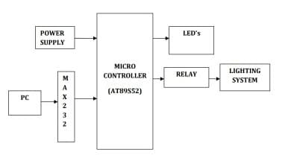
ARCHITECTURE

Slide 8
IMPLEMENTATION
Hardware Setup
PC with Control Software: Develop or install software that can send commands to street light controllers.
Communication Modules: Install appropriate communication modules on both the PC and street light controllers (e.g., Wi-Fi modules, Zigbee transceivers).
Microcontroller on Street Lights: Typically, an Arduino, ESP8266, or similar microcontroller to receive commands and control the light switch.
Software Development
User Interface: Develop a GUI or command-line interface on the PC for user interaction.
Communication Protocols: Implement the chosen communication protocol in both the PC software and microcontroller firmware.
Control Logic: Program the microcontroller to interpret commands (e.g., turn on/off, adjust brightness) and control the relay or switch accordingly.

Slide 9
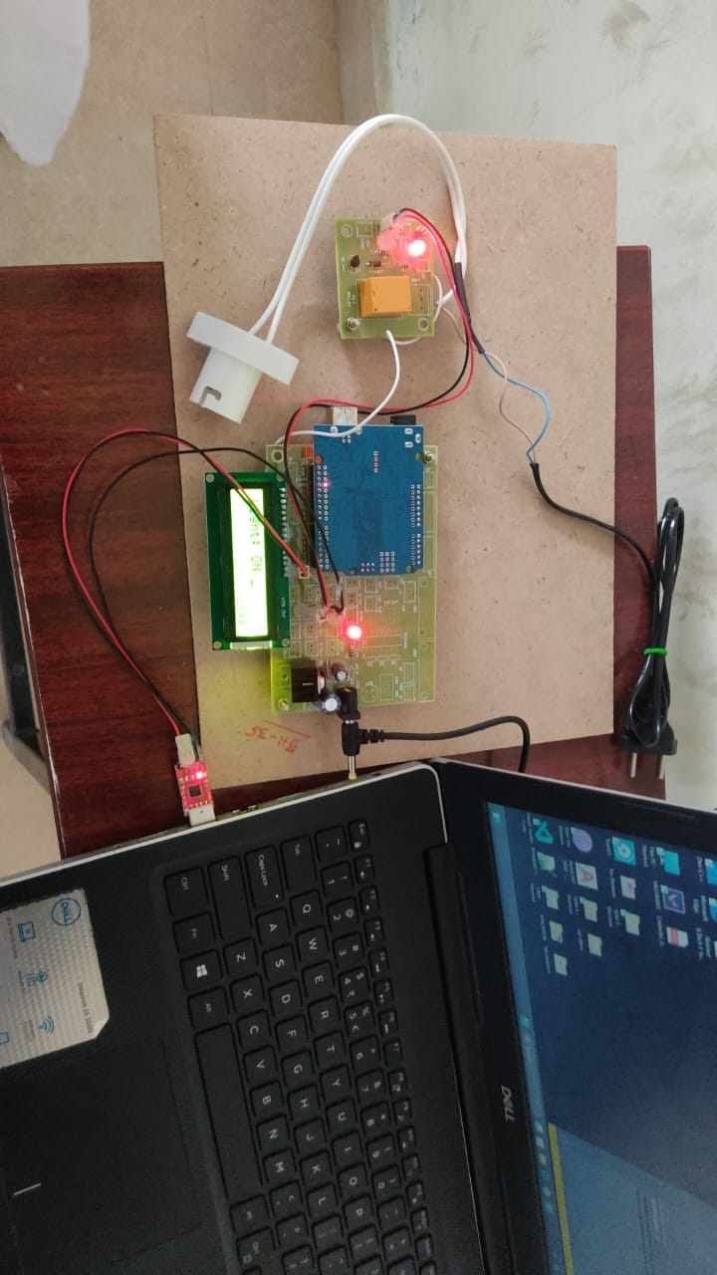
RESULTS & DISCUSSION
The implementation of a command-based street light controlling system through a PC yields several beneficial results, enhancing both functionality and efficiency. Here's a detailed look at the outcomes:
Enhanced Control and Monitoring
Energy Efficiency
Operational Efficiency
Cost Savings
Improved Public Safety and Convenience
Environmental Impact

Slide 10
CONCLUSION AND FUTURE SCOPE
The development and implementation of a command-based street light controlling system through a PC mark a significant advancement in urban infrastructure management.
The primary benefits of this system include enhanced energy efficiency, reduced operational costs, and improved public safety, contributing to the broader objectives of smart city initiatives.
Utilizing artificial intelligence to predict lighting needs based on traffic patterns, weather conditions, and event schedules. Implementing machine learning algorithms to predict and address maintenance needs before they result in system failures.

Slide 11
REFERENCES
Arduino. (n.d.). Arduino Documentation. Retrieved from https://www.arduino.cc/reference/en/
Espressif Systems. (n.d.). ESP8266EX & ESP32 Series Resources. Retrieved from https://www.espressif.com/en/support/documents/technical-documents
OASIS. (n.d.). MQTT Version 3.1.1. Retrieved from http://docs.oasis-open.org/mqtt/mqtt/v3.1.1/os/mqtt-v3.1.1-os.html
LoRa Alliance. (n.d.). LoRaWAN Specifications. Retrieved from https://lora-alliance.org/resource_hub/lorawan-specification-v1-0/
Naik, N., & Priya, K. (2017). Smart Street Lighting System Using IoT. International Journal of Advanced Research in Computer and Communication Engineering, 6(7), 321-325. Retrieved from https://www.ijarcce.com/upload/2017/july-17/IJARCCE%2063.pdf
Raspberry Pi Foundation. (n.d.). Raspberry Pi Documentation. Retrieved from https://www.raspberrypi.org/documentation/

Slide 12
Q&A

Slide 13
THANK YOU

